Slide 1

Pet Adoption
System
Detailed Design

Slide 2

Table of contents
system Overview
Database Structure
System Functionality
User Workflows
Technical Architecture
Conclusion

Slide 3


Overview
The pet adoption application is designed to facilitate the process of connecting animals in need with potential adopters. The system provides a platform for managing pet listings, user accounts with different permission levels, adoption applications, and visit tracking, creating a streamlined process for both the organization staff and potential adopters.

Slide 4

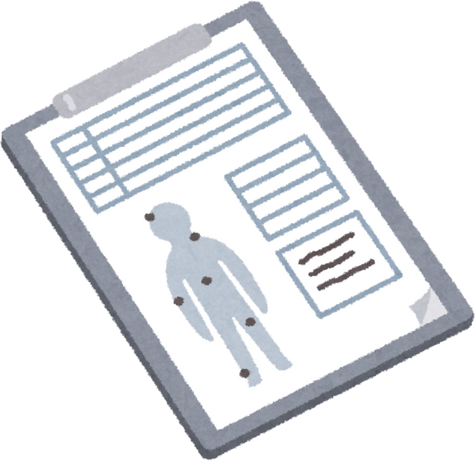

Database Structure
01
02
03
04
Users Collection
Admin: Has complete system access and management capabilities
Staff: Organization employees with moderate permissions
Adopter: End users interested in adopting pets
Pets Collection
Each pet record includes:
Unique identifier
Name
Breed classification
Status (available or adopted)
Applications Collection
Each application contains:
Unique identifier (using shortened UUID format)
Reference to the specific pet (petId)
Application status (pending or approved)
Timestamp of submission
Visits Collection
Designed to track in-person visits between potential adopters and pets
Currently implemented but contains no records

Slide 5

System Functionality
Pet Inventory Management
Adoption Application Process
Visit Coordination
User Management
User registration and authentication
Role-based access controls and permissions
Profile management
Adding new pets to the system
Updating pet information and status
Removing pets from the available pool when adopted
Submission of adoption applications by potential adopters
Application review and status updates by staff
Tracking application history
Scheduling of in-person visits between potential adopters and pets
Visit tracking and feedback collection

Slide 6
User Workflows
Admin
Complete system management
User account approval and management
Oversight of all adoption applications
Reports and analytics access

Slide 7
User Workflows
Staff
Pet profile creation and management
Application review and processing
Visit scheduling and coordination
Limited system configuration access

Slide 8
User Workflows
Adopter
Browse available pets
Submit adoption applications
Schedule visits with pets of interest
Track application status

Slide 9
Technical Architecture
01
Frontend: User interface for different user roles
02
Backend API: Business logic and data processing layer
03
Database: JSON-based data store (likely using a solution like json-server for development)

Slide 10
Conclusion
The pet adoption system provides a foundational functional totality for managing the operation of the core elements of an adoption process. The current implementation of the system offers basic functionality, however, improvements in the realm of security, data modeling, and feature set would offer a much improved system that is more effective and beneficial to users.

Slide 11
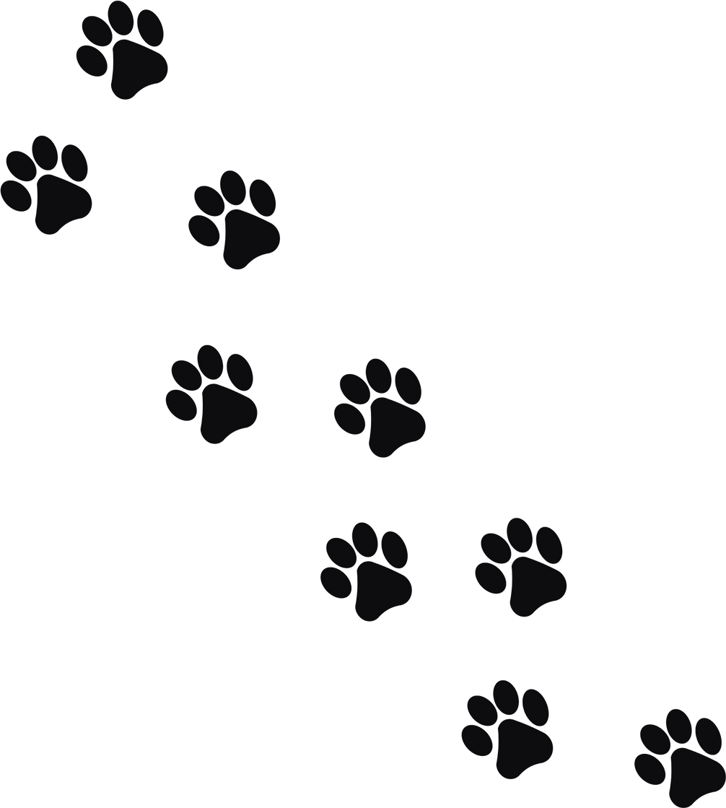
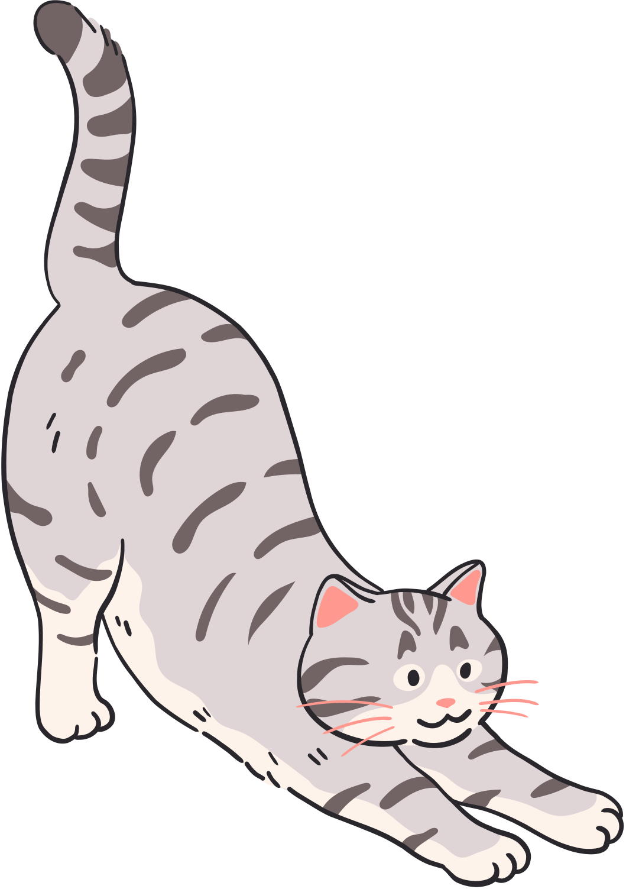
Pet Adoption System

